Slide 1
Java Type Casting

Slide 2
Java Type Casting
Type casting is when you assign a value of one primitive data type to another type.
In Java, there are two types of casting:
Widening Casting (automatically) - converting a smaller type to a larger type size byte -> short -> char -> int -> long -> float -> double
Narrowing Casting (manually) - converting a larger type to a smaller size type double -> float -> long -> int -> char -> short -> byte
Widening Casting
Widening casting is done automatically when passing a smaller size type to a larger size type:

Slide 3
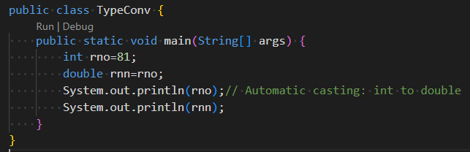


Slide 4
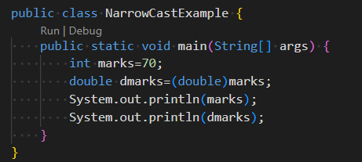

Narrowing Casting
Narrowing casting must be done manually by placing the type in parentheses in front of the value:

